Slide 1
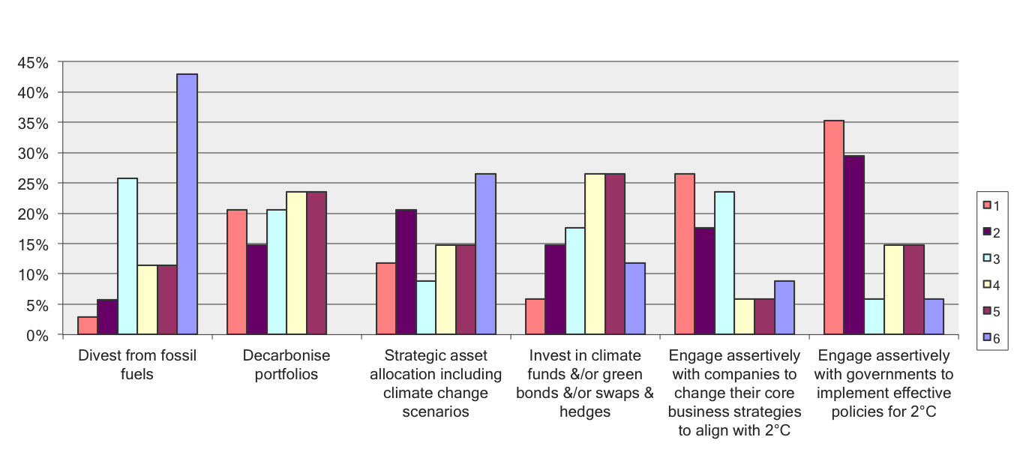
With 1 being the most effective and 6 being the least, please rank the following strategies the world’s 100 biggest institutional investors could take in order to combat the effects of “big climate risk”
What investment ‘positive mavericks’ think
Engage with
Companies
Engage with
Govts

